Slide 1
IoT Smart Monitoring System for Refrigeration
CH Vamsee Krishna

Slide 2
Project Objective
The primary technical objective is to design and build a connected, real-time monitoring system. This system is capable of:
Sensing critical environmental parameters: door status, spoilage-related gases, and external gas leaks.
Processing sensor data locally to determine if an alarm state is met.
Actuating both a local, audible alarm and a remote, instant mobile notification.
Logging all sensor data to a cloud platform for live visualization and historical analysis.

Slide 3
Components Used
Microcontroller: ESP32
Chosen for its built-in Wi-Fi, multiple analog-to-digital converter (ADC) pins, and processing power.
Prototyping:
Solderless Breadboard: The base for building and testing the prototype circuit without permanent soldering.
Sensors (Input):
MQ-3 Alcohol Sensor: Detects ethanol vapours (spoilage).
MQ-2 Gas Sensor: Detects LPG, methane, and smoke (gas leak).
Light Dependent Resistor (LDR): Detects light to determine door status.
Actuators & Indicators (Output):
Active Buzzer: Provides an audible alarm.
5mm LEDs (Red & Green): Provide a visual indicator of system status.
Passive Components:
10kΩ Resistor: Used as a pull-down resistor in the LDR's voltage divider circuit, ensuring a stable "dark" reading.
220Ω Resistors (x2): Act as current-limiting resistors for the red and green LEDs, protecting them from the ESP32's 3.3V output.

Slide 4

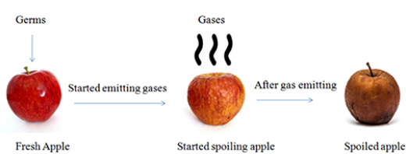
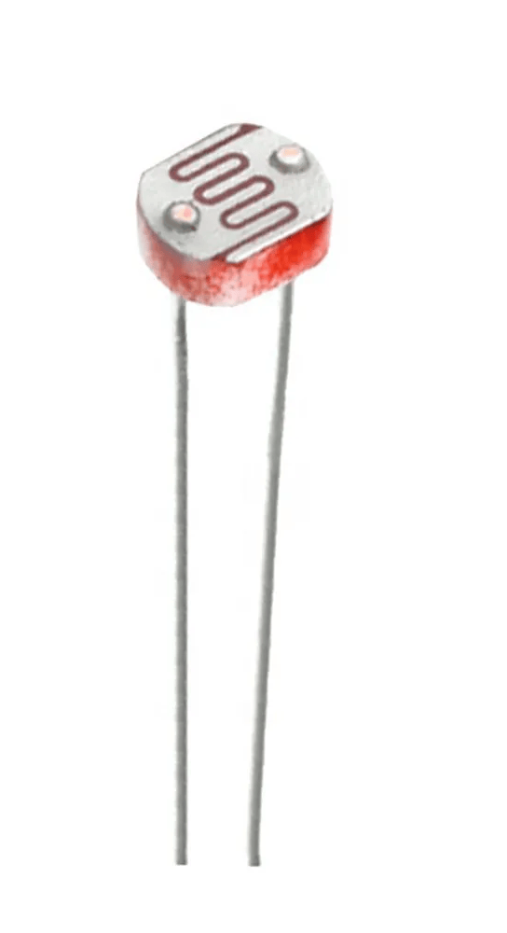
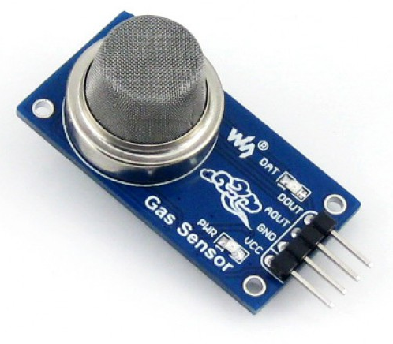
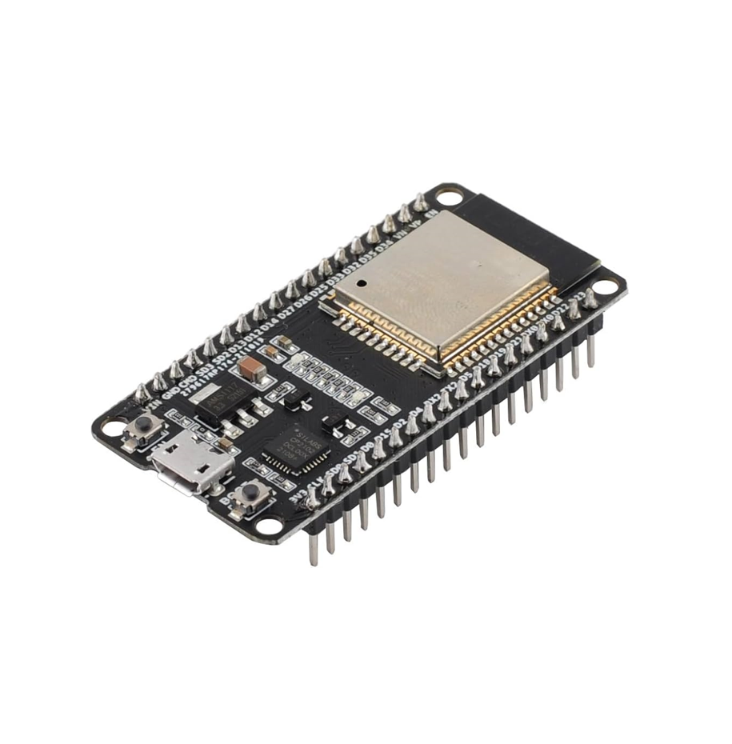

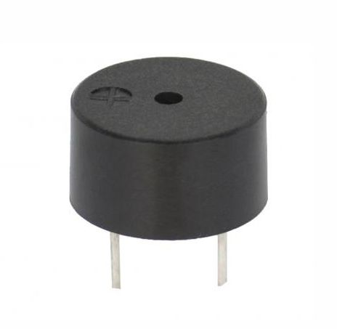

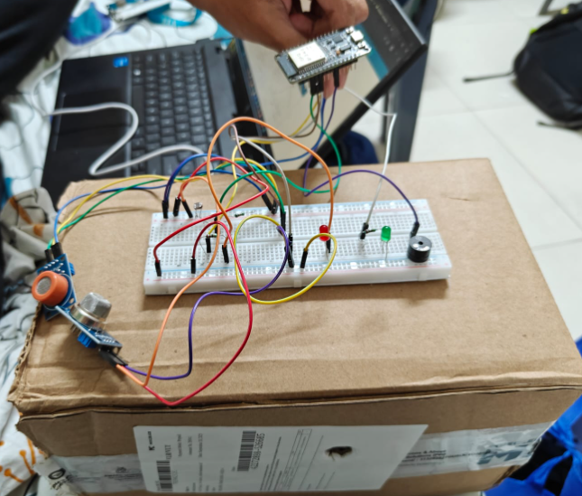
System Architecture
Fridge Light
ESP-32
Gas Sensor triggered
LDR triggered
Input (Sensors):
LDR (Door)
MQ-3 (Spoilage)
MQ-2 (Gas Leak)
Processing (ESP32):
The ESP32 reads analog data from all sensors.
It compares readings to pre-set thresholds.
It manages Wi-Fi connectivity.
Local Output (Actuators):
Buzzer (Alarm)
Red/Green LEDs (Status)
Cloud & Remote Output:
The ESP32 sends data via Wi-Fi to the ThingSpeak Cloud.
ThingSpeak logs the data and (using its "React" app) triggers a Pushbullet API call.
Pushbullet sends a final push notification to the user's mobile device.
LDR
MQ Gas Sensor
Alerts: LED, Buzzer, Mobile Notifications

Slide 5
Hardware Implementation: Wiring
Power: All sensors and LEDs share a common GND and 3.3V rail from the ESP32.
Sensor Analog Outputs:
LDR (A0) → GPIO 34 (ADC1_CH6)⁶
MQ-3 (A0) → GPIO 35 (ADC1_CH7)
MQ-2 (A0) → GPIO 32 (ADC1_CH4)
Actuator Digital Outputs:
Green LED (+) → GPIO 4
Red LED (+) → GPIO 2
Buzzer (+) → GPIO 27

Slide 6
System Logic & Thresholds
Alarm Type | Trigger Sensor | Threshold(not fixed)
Gas Leak | MQ2 | >650
Spoilage | MQ3 | >2000
Door Open | LDR | >1000, 30s
Prioritization: The logic checks for alarms in order of severity. A Gas Leak (Alarm 3) will override a Spoilage (Alarm 2) or Door (Alarm 1) alarm to ensure the most critical alert is sent.
Alarm State: A single integer variable (alarmState) is used to track the system status (0=OK, 1=Door, 2=Spoilage, 3=Gas).

Slide 7
Cloud Integration: ThingSpeak
ThingSpeak.com serves as the project's cloud-based IoT platform.
Function: It is used to log and visualize the sensor data sent from the ESP32.
Mechanism:
The ESP32 connects to Wi-Fi and uses the ThingSpeak library.
On every alarm or once per minute, the device makes an HTTP POST request to the ThingSpeak API, using a unique Write API Key.
The request populates four data fields on the channel.
Channel Fields:
Field 1: LDR Value
Field 2: Spoilage (MQ-3) Value
Field 3: Alarm Status (0, 1, 2, or 3)
Field 4: Gas (MQ-2) Value
Outcome: This data is automatically plotted on time-series graphs in the channel's "Private View," providing a live dashboard.

Slide 8
Real-Time Alerts: Pushbullet
Pushbullet is the service used to bridge the gap from a cloud event to an instant mobile notification.
Function: To send a specific, low-latency alert to a mobile phone when an alarm is triggered.
Mechanism (Event-Driven):
We use the ThingSpeak "React" App to watch the "Alarm Status" (Field 3).
Three separate "Reacts" are created:
React 1: Triggers if Field 3 = 1
React 2: Triggers if Field 3 = 2
React 3: Triggers if Field 3 = 3
When a React is triggered, it uses the "ThingHTTP" action to send a POST request directly to the Pushbullet API.
This request includes a secret Access Token (for authentication) and a JSON "body" that specifies the notification's title and message (e.g., "title": "🔥 GAS LEAK DETECTED!").
The Pushbullet app on the phone receives this API call and displays the notification.

Slide 9
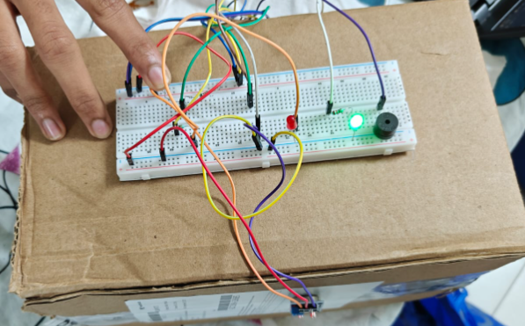
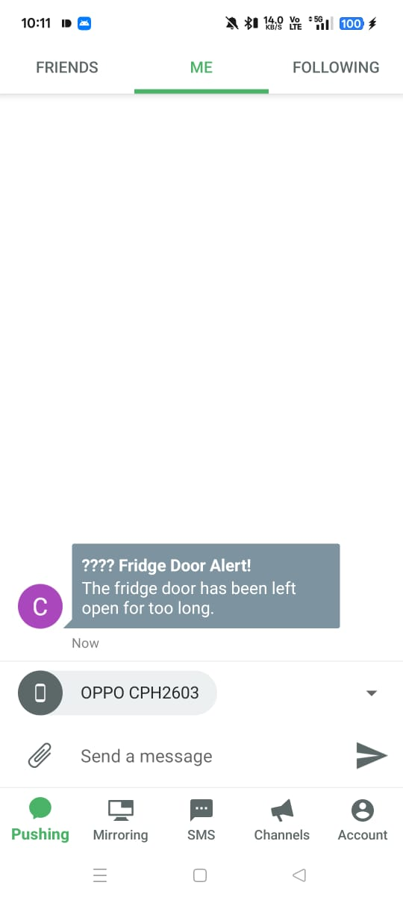
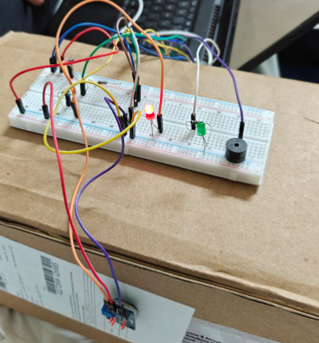
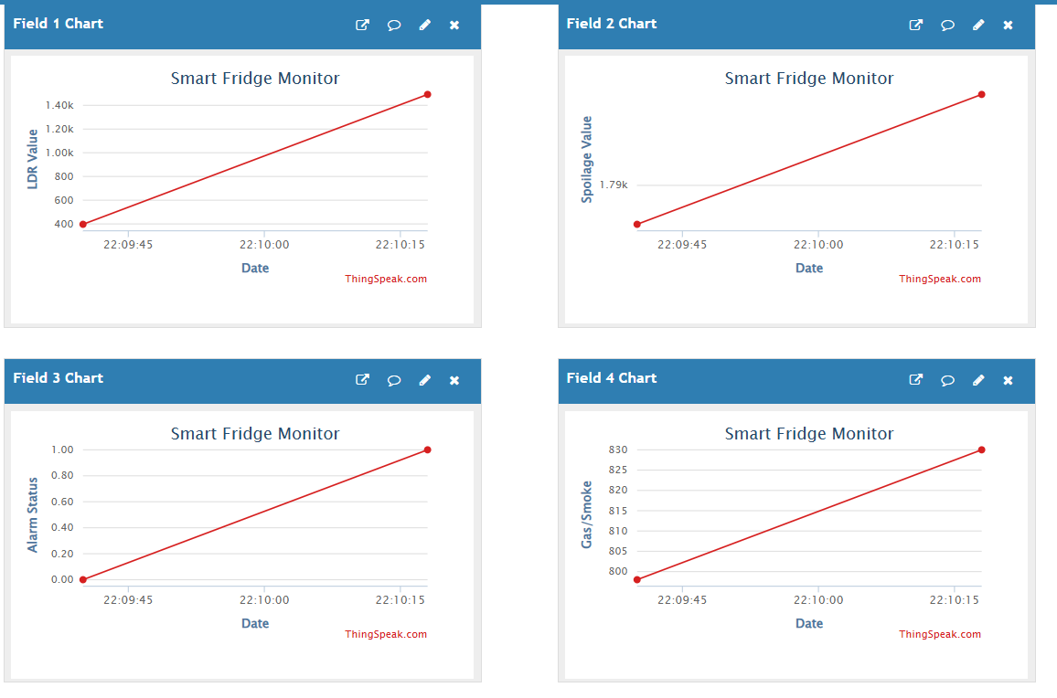
Demonstration
Test case 1: Door Open Alarm (Alarm 1)
Action: The LDR sensor is uncovered for 30+ seconds.
Local Result: The red LED and buzzer activate.
Cloud Result: "Alarm Status" (Field 3) on ThingSpeak changes to 1.
Mobile Result: A Pushbullet notification for "Fridge Door Alert!" is received.
Thingspeak website: Shows real-time updates on charts

Slide 10
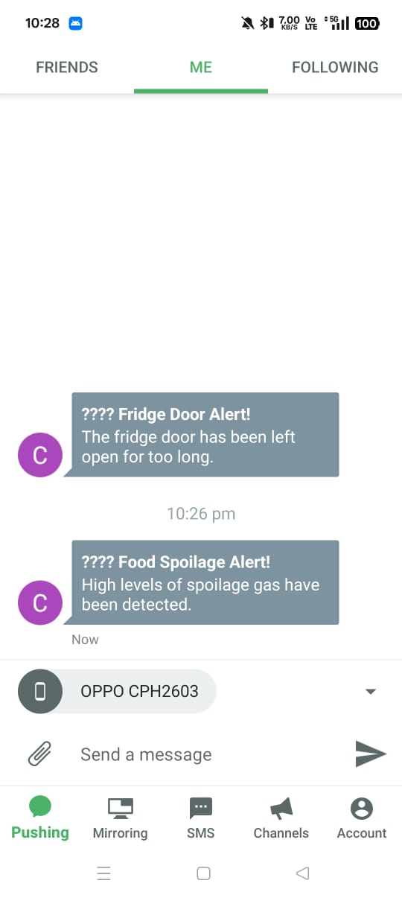
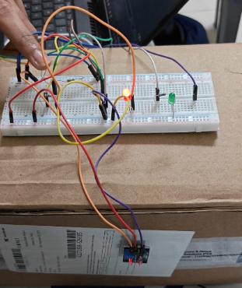
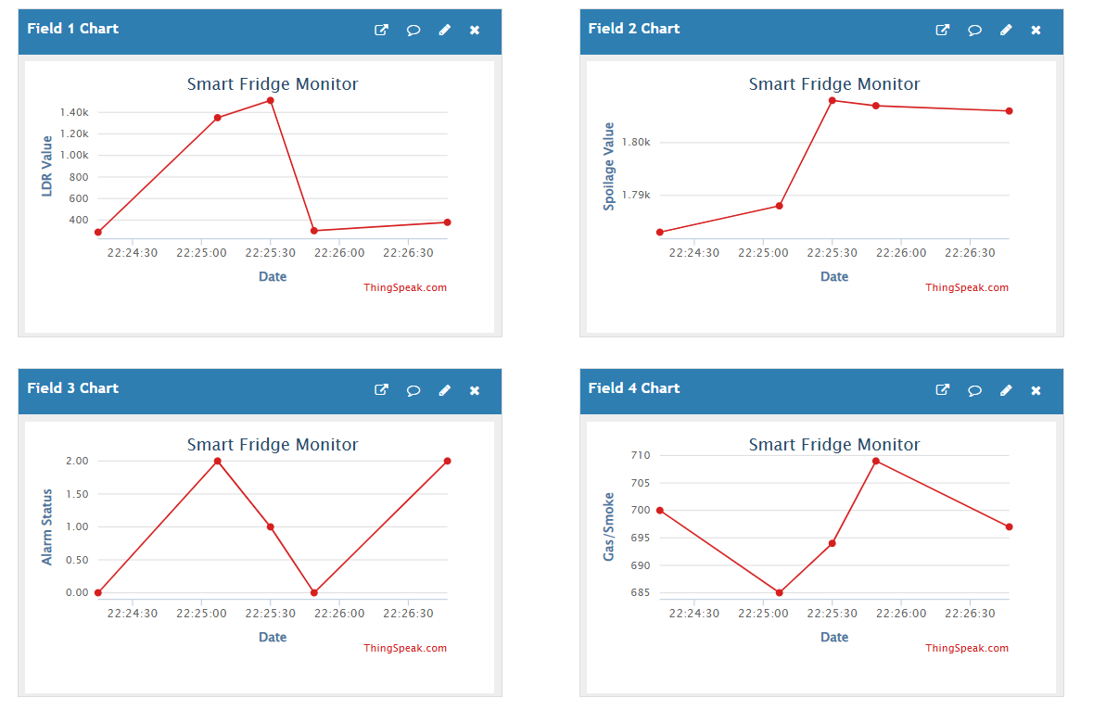
Demonstration
Test Case 2: Spoilage Alarm Test (Alarm 2)
Action: A cloth with 70% isopropyl alcohol is brought near the MQ-3 sensor.
Local Result: The red LED and buzzer activate instantly.
Cloud Result: "Alarm Status" (Field 3) on ThingSpeak changes to 2.
Mobile Result: The notification for "🍎 Food Spoilage Alert!" is received.
Thingspeak website: Shows real-time updates on charts

Slide 11
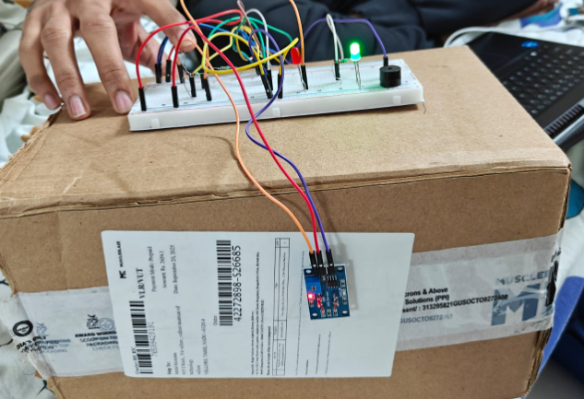
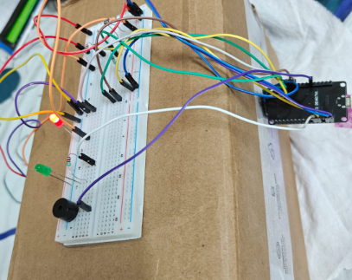
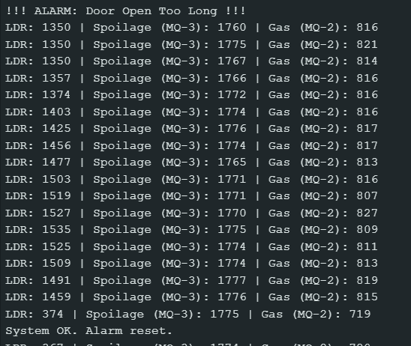
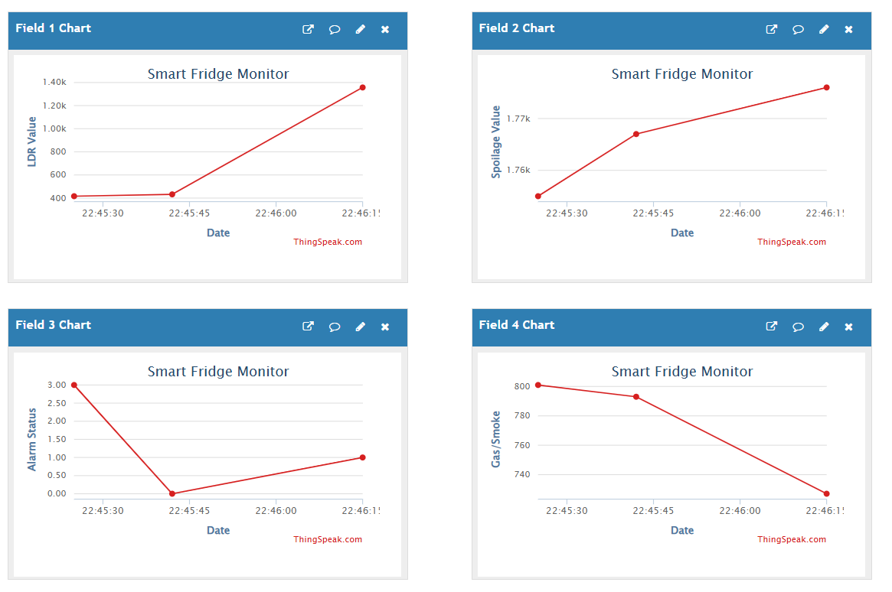
Demonstration
Test Case 3: System Reset
Action: All alarm conditions are removed (door closed, gas removed).
Local Result: The red LED and buzzer turn off. The green "System OK" LED turns on.
Cloud Result: "Alarm Status" (Field 3) on ThingSpeak changes back to 0.

Slide 12
Conclusion & Future Work
Future Work
-Path from Prototype to Product
Sensor Enhancement:
Explore more reliable door sensors, like a magnetic reed switch or IR proximity sensor.
Integrate an MQ-135 Air Quality Sensor to detect a wider range of spoilage-related gases (like ammonia and sulfides).
Hardware Optimization:
Investigate lower-power Wi-Fi microcontrollers to reduce energy consumption and make a battery-powered version feasible.
Design and 3D print a custom, compact, and food-safe enclosure to house the final PCB and sensors.
Next-Generation Sensing:
Research tailor-made sensors (e.g., using nanotechnology) that are highly sensitive to the precise volatile organic compounds (VOCs) released by food spoilage.
Software & App Development:
Replace Pushbullet with a dedicated mobile application (using a backend like Firebase) to create a professional user interface and add more features (e.g., data history, settings).
Conclusion
This project successfully demonstrates a viable proof-of-concept for a multi-sensor IoT monitoring system.
The core objectives were met- we successfully integrated sensors to log environmental data to the ThingSpeak cloud and built an event-driven system to send immediate, prioritized mobile alerts using Pushbullet.
This prototype confirms that the chosen architecture (ESP32, cloud services) is an effective and low-cost foundation for a smart monitoring solution. The project successfully simulates the system's core logic and lays the groundwork for the future R&D needed to move from a prototype to a finished product.

